Slide 1

CGC_REBOUNDER Team member Himanshu Kumar (Captain)-Embedded Developer Bhawna Rajput- Android Developer Nikhil Yadav-Embedded Developer

Slide 2

INSTALLATION GUIDE

Slide 3
Technology Used
Android Studio-JAVA
Real Term Software for Testing the cases
Embedded Hardware Device
Chipset ESP8266
Chipset Coding in Python(.pde Extension)

Slide 4
Android Studio
Hardware and Software specification:-
Windows OS
Microsoft Windows 7/8/10 (32-bit or 64-bit)
2 GB RAM minimum, 8 GB RAM recommended.
2 GB of available disk space minimum, 4 GB Recommended (500 MB for IDE + 1.5 GB for Android SDK and emulator system image)
1280 x 800 minimum screen resolution.
JDK 8.

Slide 5
Real Term Software
Real Term is Basically used to check test cases ,to interact with software on your PC, not with a physical port as normal, the you need com0com .
This makes a pair of virtual comports, linked together.
You software connects to one port, and Realterm connects to the other.
Now Realterm can talk to your software and see what it is sending.
We have used this for Checking the test case with Our Android App in order to check the Functionality with ESP8266 chipset

Slide 6
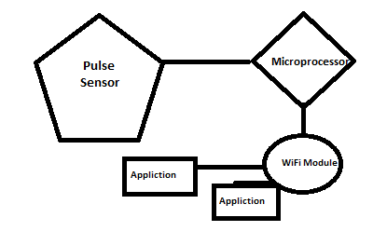
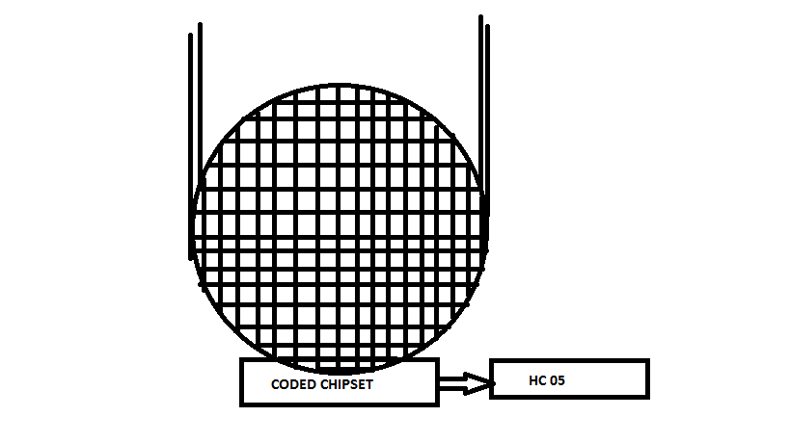
Embedded Hardware Device
Basically we have used this in order to Provide
Functionality to Elders
It has to be embedded on te Elder wrist
attached with the Coded chipset
Will starts working
When Ever the Pulse will starts twitch
After Calculating the twitch Part the output and the calculated result will be
Transferred through ESP8266 WiFi chipset
Formula Used in the Chipset:- Average Pulse Rate = 60 and 100 beats
per minute (bpm)

Slide 7
Chipset
ESP 8266 chipset is Used for the Transfer and sharing Functionality
Coded Chipset is present There where we will embedded our Python Code to Calculate the Function Data and transfer to the ESP8266
Which in returns Provide data in our Output Mobile Screen

